Slide 1



Understanding Global Climate Change and it’s impact
Linet Osoro, Jennifer Savage, Jesse Reed, Damon Robinson

Slide 2
Agenda
Define climate change
Importance of understanding and addressing it
Causes of climate changes
Evidence of climate change
Impact of Climate change
Vulnerable Regions
Global efforts to address Climate Change
Individual Actions
Final tips & takeaways
Notes:
Slide: Linet

Slide 3
What We Looked At
Livestock population – red meat and poultry
Crop production
Climate trends – temperature and precipitation
CO2 levels
Methane levels
Notes:
Slide: Linet

Slide 4
Data Exploration and Cleaning
Sources:
kaggle.com
data.world
epa.gov
climate.gov
SQL:
add csv files and store in database
generate queries
Python libraries:
Pandas
Matplotlib
Seaborn
Folium
Plotly
Cleaning:
Sorted and grouped by temp and emissions
dropped null values
Notes:
Slide: Linet

Slide 5
Introduction
Define Climate Change
Climate Change vs Climate Variability
Importance of Understanding Climate Change
Notes:
Slide: Jesse

Slide 6
What is global climate change?
Notes:
Slide: Jesse
Climate change involves significant changes in average conditions—such as temperature, precipitation, wind patterns, and other aspects of climate that occur over years, decades, centuries, or longer.
Climate change involves longer-term trends, such as shifts toward warmer, wetter, or drier conditions. These trends can be caused by natural variability in climate over time, as well as human activities that add greenhouse gases to the atmosphere like burning fossil fuels for energy.

Slide 7
Climate change or climate variability?
Notes:
Slide: Jesse
Climate change occurs over a long period of time, typically over decades or longer. In contrast, climate variability includes changes that occur within shorter timeframes, such as a month, season, or year.
Climate variability explains the natural variability within the system. For example, one unusually cold or wet year followed by an unusually warm or dry year would not be considered a sign of climate change.
Higher summer temperatures are linked to an increased risk of heat-related illnesses and death. Older adults, pregnant women, and children are at particular risk, as are people living in urban areas because of the additional heat associated with urban heat islands.
Climate change is expected to expose more people to ticks that carry Lyme disease or other bacterial and viral agents, and to mosquitoes that transmit West Nile and other viruses.
More frequent extreme weather events such as droughts, hurricanes, floods, and wildfires will not only put people’s lives at risk, but can also worsen underlying medical conditions, increase stress, and lead to adverse mental health effects.
Rising temperatures and extreme weather have the potential to disrupt the availability, safety, and nutritional quality of food.

Slide 8
Why is understanding climate change important?
Notes:
Slide: Jesse
Higher summer temperatures are linked to an increased risk of heat-related illnesses and death. Older adults, pregnant women, and children are at particular risk, as are people living in urban areas because of the additional heat associated with urban heat islands.
Climate change is expected to expose more people to ticks that carry Lyme disease or other bacterial and viral agents, and to mosquitoes that transmit West Nile and other viruses.
More frequent extreme weather events such as droughts, hurricanes, floods, and wildfires will not only put people’s lives at risk, but can also worsen underlying medical conditions, increase stress, and lead to adverse mental health effects.
Rising temperatures and extreme weather have the potential to disrupt the availability, safety, and nutritional quality of food.

Slide 9
Contributors to Climate Change
Human effect
Greenhouse gases
Fossil fuels
Weather events
Agriculture
Notes:
Slide: Jennifer
Human activities have contributed substantially to climate change through green house gas emissions. Concentrations of the green house gases have increased since the industrial revolution. Green house effect causes temperature rises.
Burning fossil fuels changes the climate more than any other human activity.
Carbon dioxide, methane and nitrous oxide are more abundant in the earth atmosphere than in any time in 800, 00 years.
Activities such as agriculture, road construction, and deforestation can change the reflectivity of the earth's surface, leading to local warming or cooling. This effect is observed in heat islands, which are urban centers that are warmer than the surrounding, less populated areas.
Change in suns energy output can affect the intensity of the sunlight that reaches the earth surface. Solar variations have played little role in the climate change
Volcanoes eruptions release large quantities of carbon dioxide, human activities emit more than 100 times as much carbon dioxide as volcanoes each year.

Slide 10
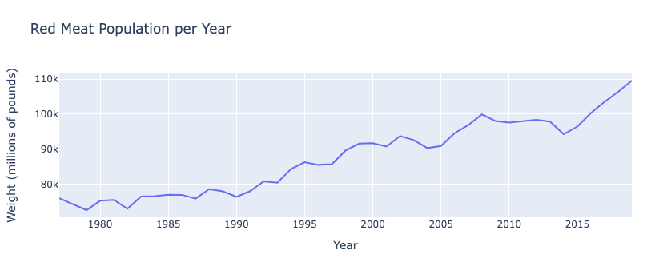
Livestock and Farming
Notes:
Slide: Jennifer
The population of red meat has increased since 1980 and has taken a steep jump since 2015

Slide 11
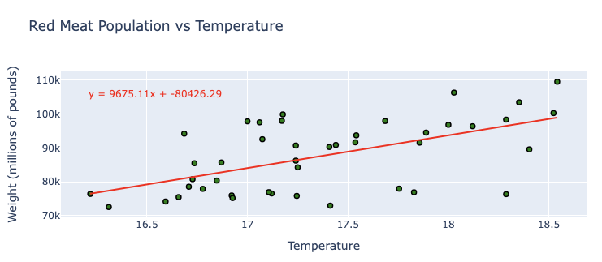
Livestock and Farming
Notes:
Slide: Jennifer
There is a loose positive correlation between the temperature and the population of red meat. The higher the temperature, the higher the population of red meat.

Slide 12
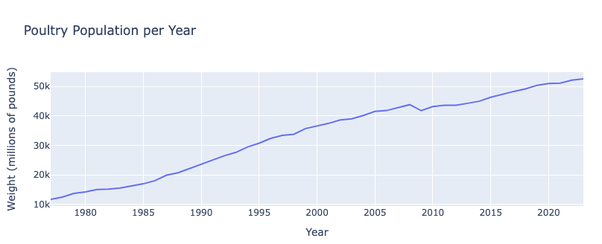
Livestock and Farming
Notes:
Slide: Jennifer
The poultry population is almost 5 times higher now than it was in 1980. It has steadily increased.

Slide 13
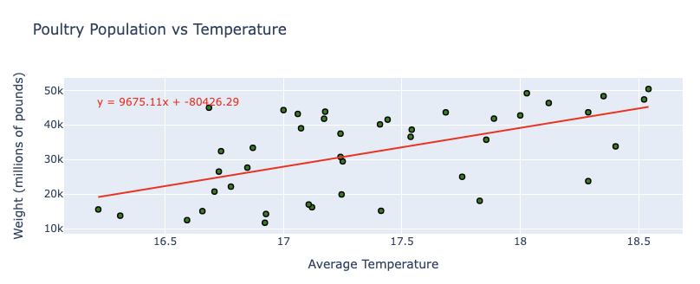
Livestock and Farming
Notes:
Slide: Jennifer
There is a very loose positive correlation between average temperature and weight of poultry

Slide 14
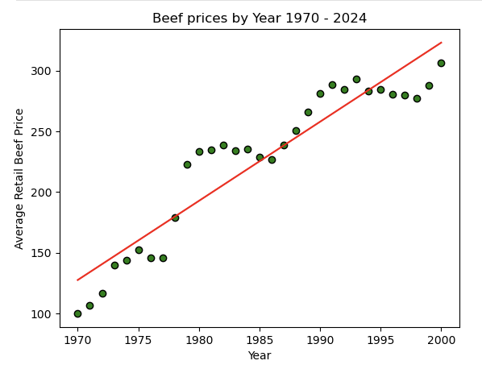
Livestock and Farming
Notes:
Slide: Jennifer
Steady increase in beef prices

Slide 15
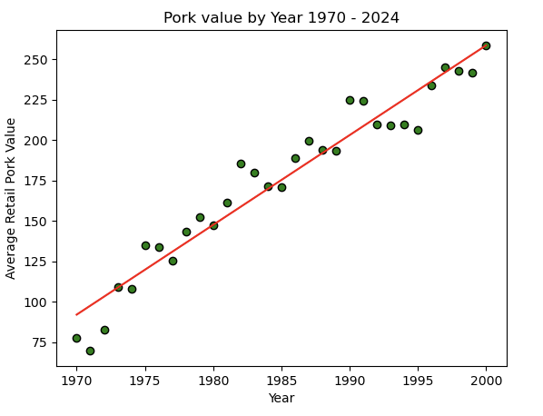
Livestock and Farming
Notes:
Slide: Jennifer
Steady increase in pork prices

Slide 16
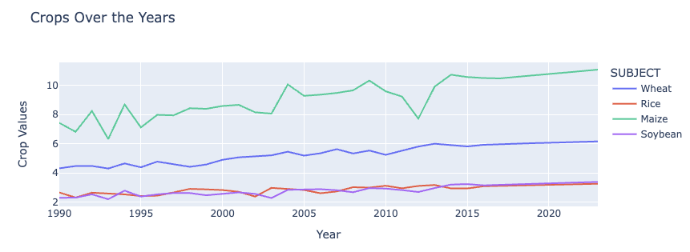
Livestock and Farming
Notes:
Slide: Jennifer
There has not been a dramatic increase in crop production over the years, but there has been an increase. Maize has had the most dramatic increase.

Slide 17
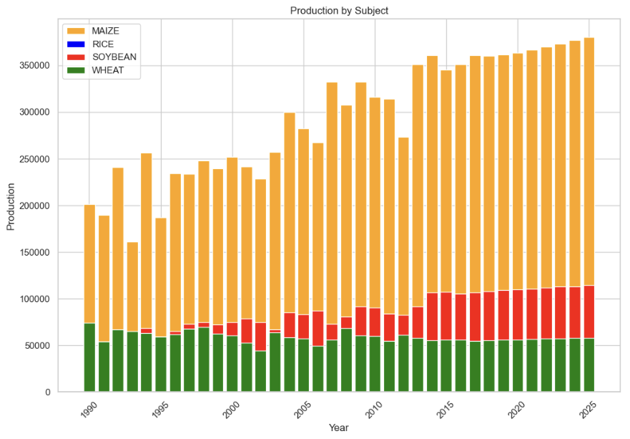
Livestock and Farming
Notes:
Slide: Jennifer
The production of croups has increased over the years overall.

Slide 18
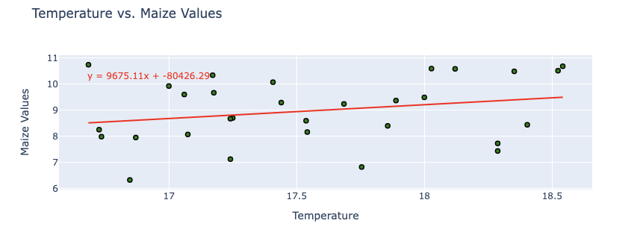
Livestock and Farming
Notes:
Slide: Jennifer
There is no correlation between average temperature and maize production

Slide 19
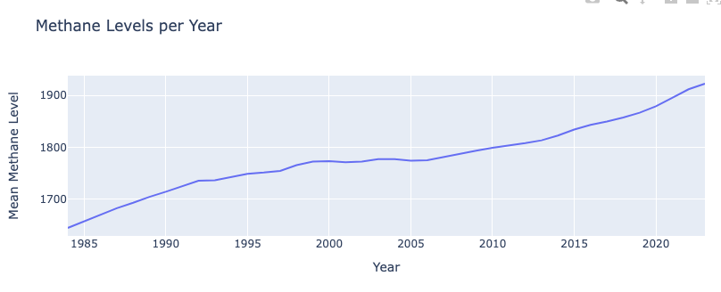
Methane Levels
Notes:
Slide: Linet
There has been a steady increase in methane levels over the past 40 years. They started to increase faster around 2007.

Slide 20
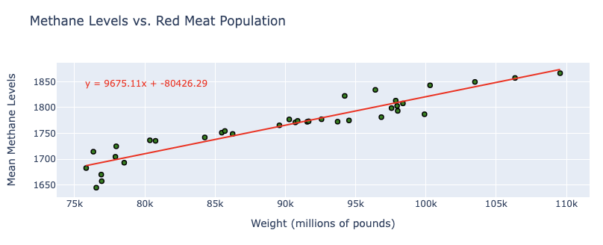
Methane Levels
Notes:
Slide: Linet
There is a strong correlation between weight of red meat and methane levels. Cows expel methane gas and the higher the cow population, the higher the methane level.

Slide 21
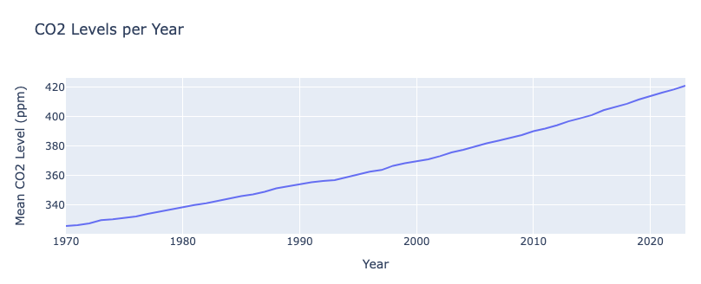
CO2 Levels
Notes:
Slide: Linet
The levels of CO2 have steadily increased over the past 50 years

Slide 22
Evidence of Climate Change
Temperature rise
Melting glaciers and ice caps
Rising sea levels
Extreme weather events
Notes:
Slide: Jesse
Warmer temperatures increase the frequency, intensity, and duration of heat waves, which can pose health risks, particularly for young children and the elderly.
Climate change can also impact human health by worsening air and water quality, increasing the spread of certain diseases, and altering the frequency or intensity of extreme weather events.
Rising sea level threatens coastal communities and ecosystems.
Changes in the patterns and amount of rainfall, as well as changes in the timing and amount of stream flow, can affect water supplies and water quality and the production of hydroelectricity
Changing ecosystems influence geographic ranges of many plant and animal species and the timing of their lifecycle events, such as migration and reproduction.
Increases in the frequency and intensity of extreme weather events, such as heat waves, droughts, and floods, can increase losses to property, cause costly disruptions to society, and reduce the affordability of insurance.

Slide 23
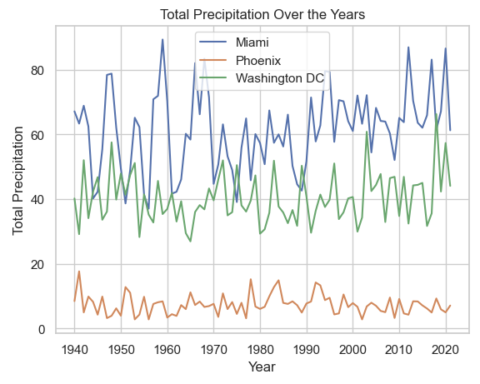
Precipitation
Notes:
Slide: Jesse
There has been no dramatic change in precipitation over the years in these three cities.

Slide 24
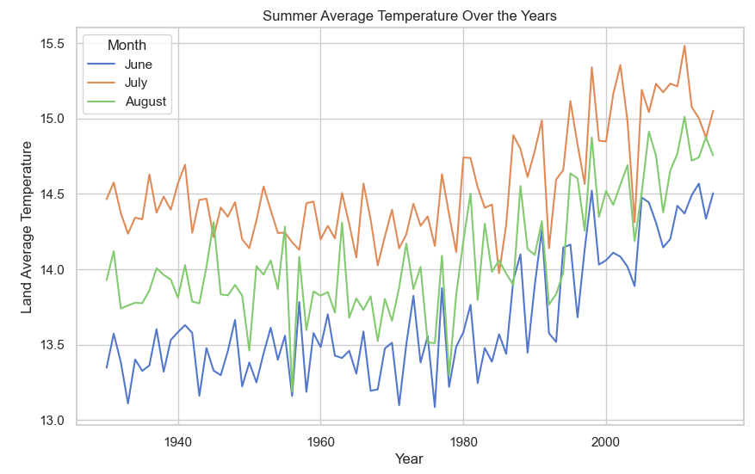
Temperatures
Notes:
Slide: Jesse
In the summer, the temperatures have increased starting around 1980.

Slide 25
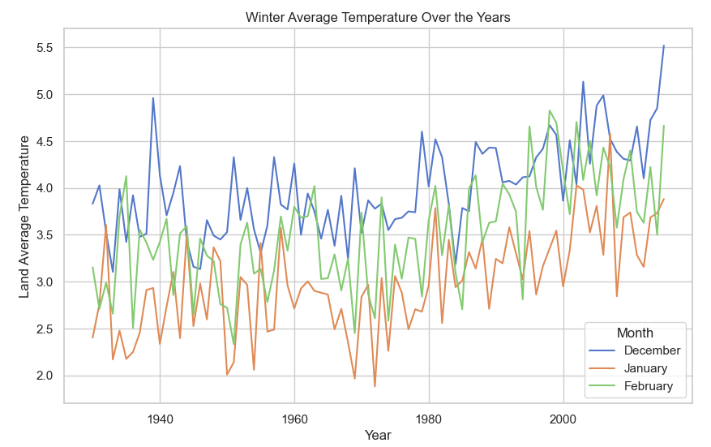
Temperatures
Notes:
Slide: Jesse
In the winter, the temperatures have increased starting around 1980.

Slide 26
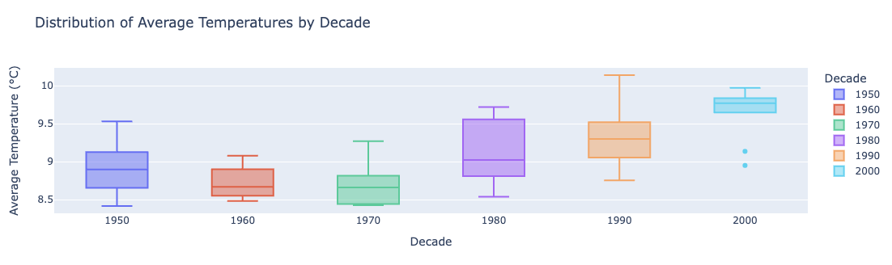
Temperatures
Notes:
Slide: Jesse
Over the decades every statistical value has increased. In the 2000s alone, besides the outliers, every statistical value except the max increased. The median average temperature was around 8.7 in the 1970s and around 9.8 in the 200s.

Slide 27
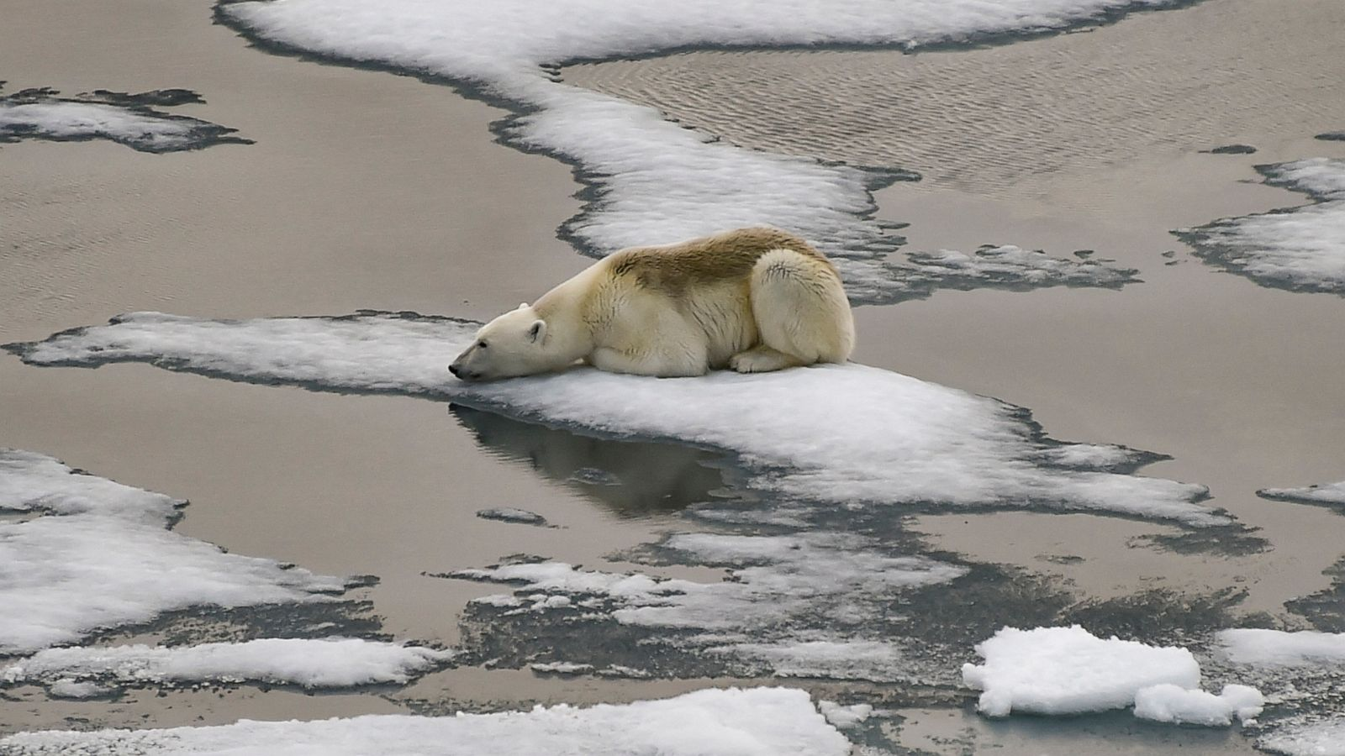
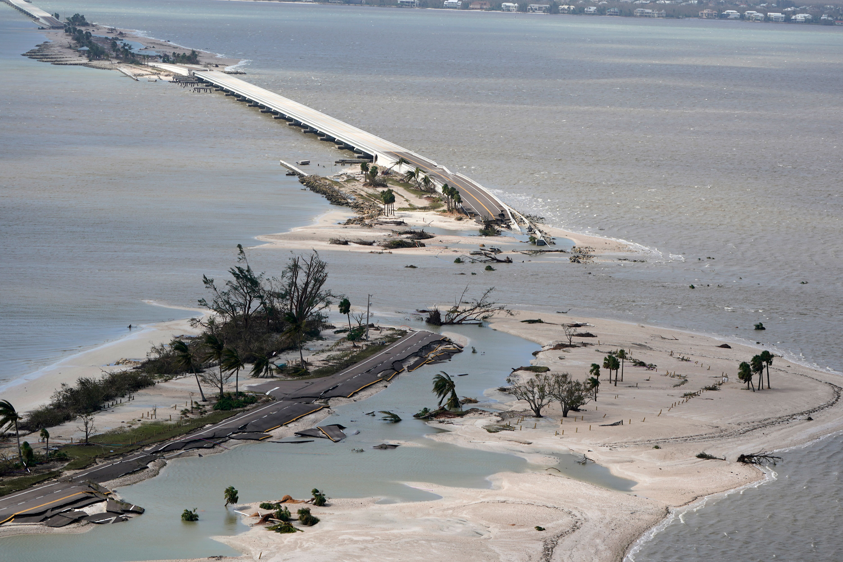
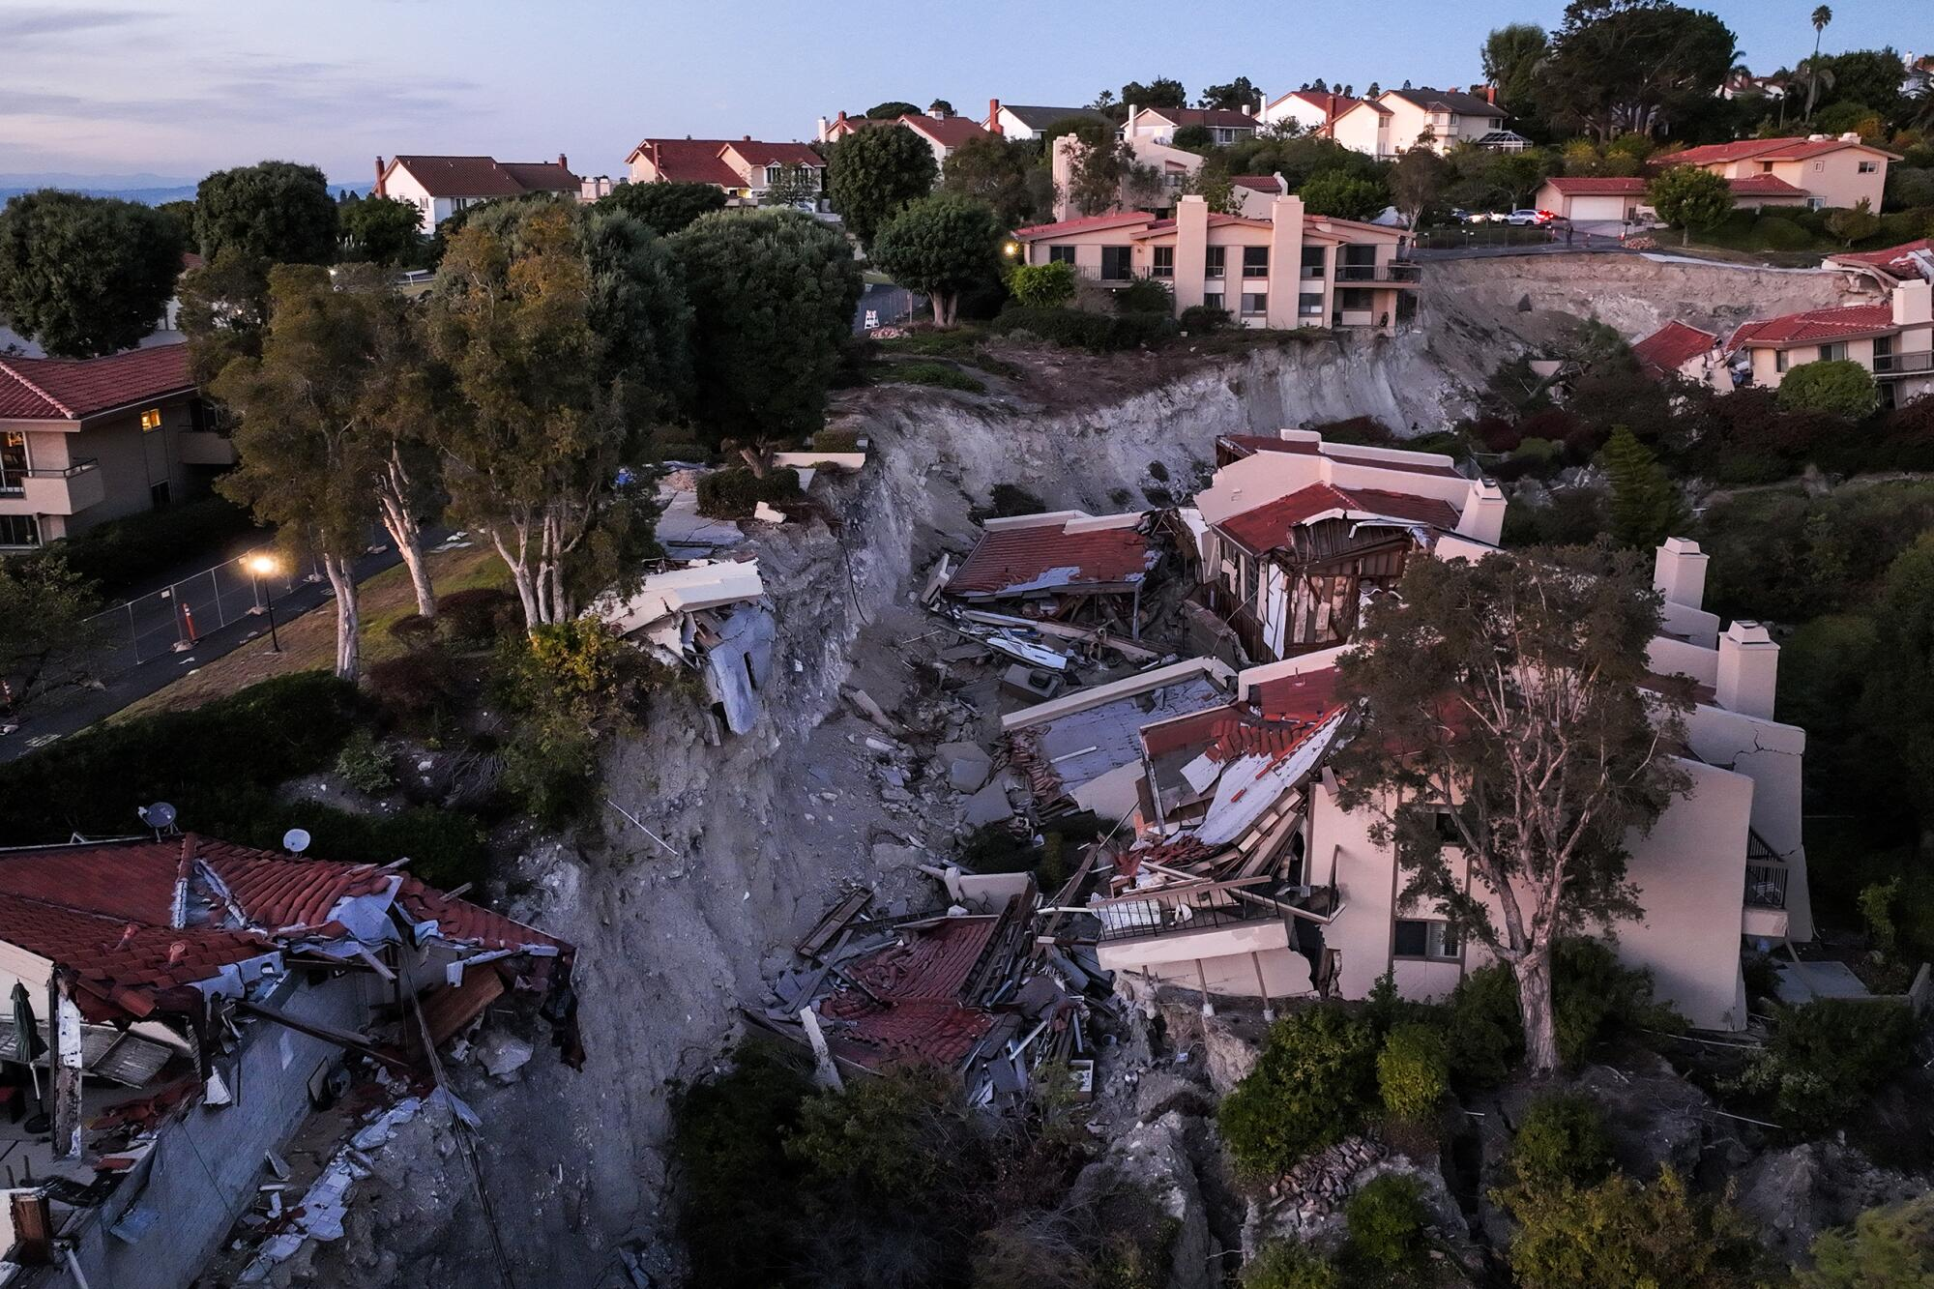
Evidence of Climate Change
Notes:
Slide: Jesse
Upper left, polar ice melting so polar bears losing home
Bottom left, landslides in California
Right: Hurricane Ian destroys bridge to Sanibel Island

Slide 28
Impacts of Climate Change
Environmental impacts (Loss of biodiversity, habitat destruction)
Social impacts (Food and water scarcity, displacement of communities)
Economic impacts (Damage to infrastructure, loss of livelihoods)
Notes:
Slide: Damon
Warmer temperatures increase the frequency, intensity, and duration of heat waves, which can pose health risks, particularly for young children and the elderly.
Climate change can also impact human health by worsening air and water quality, increasing the spread of certain diseases, and altering the frequency or intensity of extreme weather events.
Rising sea level threatens coastal communities and ecosystems.
Changes in the patterns and amount of rainfall, as well as changes in the timing and amount of stream flow, can affect water supplies and water quality and the production of hydroelectricity
Changing ecosystems influence geographic ranges of many plant and animal species and the timing of their lifecycle events, such as migration and reproduction.
Increases in the frequency and intensity of extreme weather events, such as heat waves, droughts, and floods, can increase losses to property, cause costly disruptions to society, and reduce the affordability of insurance.

Slide 29
Vulnerable Regions
Droughts, flooding, reduced food production contributes to the Global Warming Impact Score
ND Gain Index is used to analyze countries that have taken to better climate control measures
Ecological Threat Report (ETR)
Notes:
Slide: Damon
Using the global Warming Impact Score scientist are able to know which countries have high scores
Top 5 bottom countries
Afghanistan- The country has been hit by drought for 3 consecutive years which, combined with heavy flooding, has further reduced food production and rendered 23 million people highly food insecure.
Mozambique--Mozambique’s 2,300 km coastline makes it highly vulnerable to cyclones, flooding, and rising sea levels resulting in soil salinization and loss of land. According to the INFORM Climate Change Risk Index, it is the 9th most vulnerable country to climate-related hazards such as heatwaves, droughts, and floods. Mozambique was hit by the devastating Cyclone Freddy in March 2023, which caused displacement of more than 20,000 people and destruction of significant infrastructure.
Myanmar---Myanmar has been affected by at least 57 natural disasters caused by global warming since 2000, that have caused more than 7,000 deaths per year on average and an economic loss of $1.5 billion. In May 2023, the country got hit by Cyclone Mocha, the strongest cyclone ever recorded in the North Indian Ocean, that left 250,000 people in dire need of food and shelter.
Pakistan ---One of the worst impacts of global warming and climate change was the devastating monsoon floods experienced by Pakistan in 2022 that impacted the lives and livelihoods of 33 million people, destroyed 4.4 million acres of agricultural land, and killed 800,000 livestock. With increasing temperatures and rapidly melting glaciers, the country is also set to experience periods of drought which could cause more than 14.6 million people to fall prey to acute hunger.
Haiti-- ranks 17th on the Ecological Threat Report (ETR)’s list of countries that are most threatened by climate-related catastrophes. It has been hit by 80 such events since 2000 and has suffered an economic loss of $392 million. It has recently received assistance of $22.4 million from the Green Climate Fund for building climate resilience through reforestation and flood management.

Slide 30
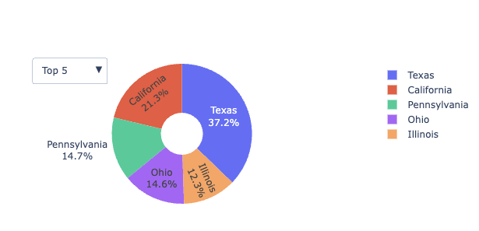
Effects From Home
Notes:
Slide: Damon
The highest contributors to co2 emissions are Texas, California, Pennsylvania, Ohio, and Illinois.

Slide 31
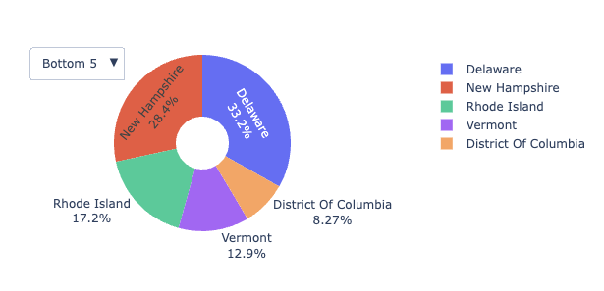
Effects from Home
Notes:
Slide: Damon
The lowest contributors to co2 emissions are Delaware, New Hampshire, Rhode Island, Vermont, and Washington DC.

Slide 32
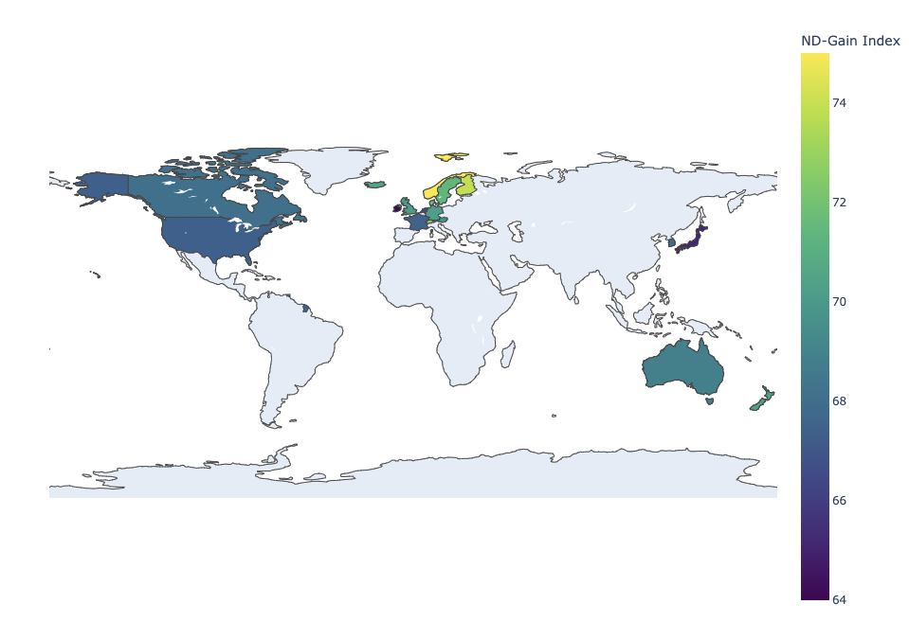
Vulnerable Regions
Notes:
Slide: Damon
The ND-GAIN Index summarizes a country's vulnerability to climate change and other global challenges in combination with its readiness to improve resilience. It aims to help governments, businesses and communities better prioritize investments for a more efficient response to the immediate global challenges ahead.
Using the global Warming Impact Score scientist are able to know which countries have high scores
Top 5 bottom countries
Afghanistan- The country has been hit by drought for 3 consecutive years which, combined with heavy flooding, has further reduced food production and rendered 23 million people highly food insecure.
Mozambique--Mozambique’s 2,300 km coastline makes it highly vulnerable to cyclones, flooding, and rising sea levels resulting in soil salinization and loss of land. According to the INFORM Climate Change Risk Index, it is the 9th most vulnerable country to climate-related hazards such as heatwaves, droughts, and floods. Mozambique was hit by the devastating Cyclone Freddy in March 2023, which caused displacement of more than 20,000 people and destruction of significant infrastructure.
Myanmar---Myanmar has been affected by at least 57 natural disasters caused by global warming since 2000, that have caused more than 7,000 deaths per year on average and an economic loss of $1.5 billion. In May 2023, the country got hit by Cyclone Mocha, the strongest cyclone ever recorded in the North Indian Ocean, that left 250,000 people in dire need of food and shelter.
Pakistan ---One of the worst impacts of global warming and climate change was the devastating monsoon floods experienced by Pakistan in 2022 that impacted the lives and livelihoods of 33 million people, destroyed 4.4 million acres of agricultural land, and killed 800,000 livestock. With increasing temperatures and rapidly melting glaciers, the country is also set to experience periods of drought which could cause more than 14.6 million people to fall prey to acute hunger.
Haiti-- ranks 17th on the Ecological Threat Report (ETR)’s list of countries that are most threatened by climate-related catastrophes. It has been hit by 80 such events since 2000 and has suffered an economic loss of $392 million. It has recently received assistance of $22.4 million from the Green Climate Fund for building climate resilience through reforestation and flood management.

Slide 33
Global Efforts to Address Climate Change
International agreements (e.g., Paris Agreement)
National policies and initiatives
Role of renewable energy
Adaptation strategies
Notes:
Slide: Linet
Climate change is a moral and ethical issue demanding urgent action.
Economic debates often overlook the true value at stake: biodiversity, community well-being, and future generations.
The IPCC warns of severe consequences, including habitat loss, species extinction, and food/water scarcity, particularly impacting the most vulnerable.
Economic analyses struggle to assign value to ecosystems intrinsic worth and the joy they bring.
Climate change raises fundamental ethical questions about our values and priorities as a society.
We must prioritize justice, equity, and sustainability in decision-making, recognizing the priceless value of protecting life on Earth.
Climate action isn't just about numbers; it's a moral imperative for a thriving future for all.

Slide 34
What You Can Do
Reduce carbon footprint (Energy conservation, using renewable energy, etc.)
Sustainable lifestyle choices (Reducing waste, eating less meat, etc.)
Advocacy and raising awareness
Notes:
Slide: Linet
We all have a part to play in helping with combating climate change, by making the right long-term decision that will help reduce our carbon print by taking small steps like recycling, reusing or just turning the AC off in the evening and opening the windows instead.

Slide 35
Final Takeaway
We all need to work together to help slow climate change.
Notes:
Slide: Linet
We all have a part to play in helping with combating climate change, by making the right long-term decision that will help reduce our carbon print by taking small steps like recycling, reusing or just turning the AC off in the evening and opening the windows instead.

